Slide 1
Descriptive Statistics

Slide 2
Overview Of Descriptive Statistics
Descriptive Statistics describes data. It is a method to collect, organize, summarize, display and analyze sample data taken from a population.
Descriptive statistics consists of methods for organizing, displaying, and describing data by using tables, graphs, and summary measures.

Slide 3
Descriptive Statistics
Descriptive Statistics consists of
• Measures of Central Tendency
• Mean
• Median
• Mode
• Measures of Dispersion
• Range
• Standard Deviation
• Frequency Distributions
• Histograms

Slide 4
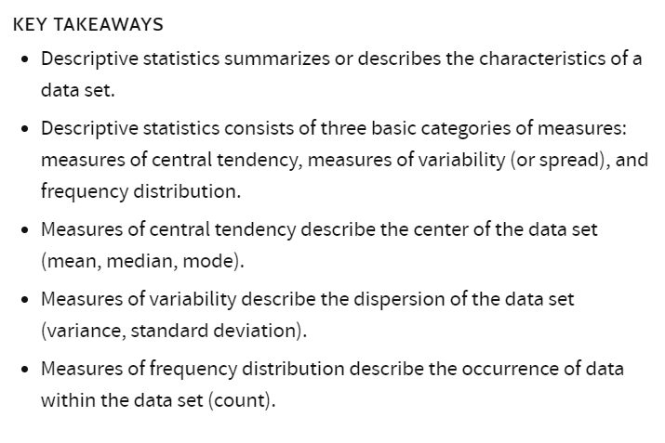
Overview Of Descriptive Statistics

Slide 5
Overview Of Inferential Statistics
Inferential statistics involves drawing conclusions about populations by examining samples. It allows us to make inferences about the entire set, including specific examples within it, based on information obtained from a subset of examples.
Inferential statistics consists of methods that use sample results to help make decisions or predictions about a population.
Inferential Statistics consists of
Hypothesis testing
ANOVA
Chi-Squared Tests
Regression

Slide 6
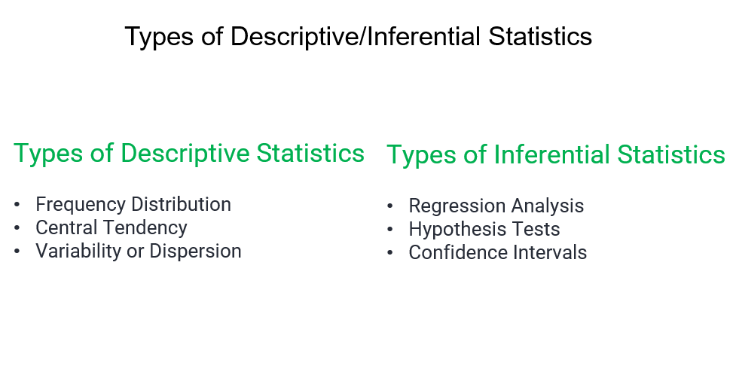

Slide 7
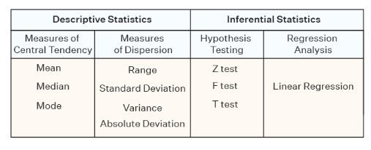

Slide 8
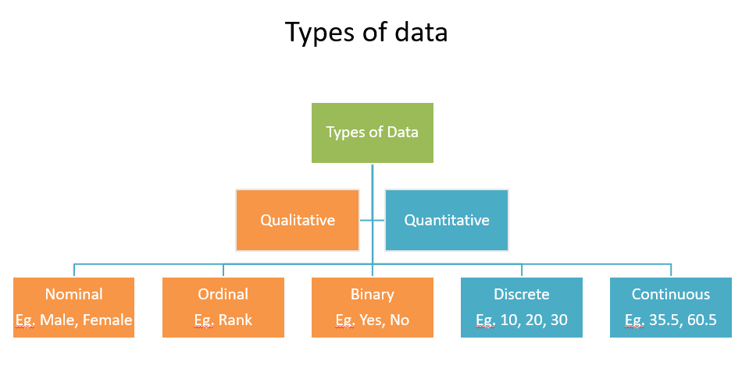

Slide 9
Nominal Data
Nominal Data is used to label variables without any order or quantitative value. The colour of hair can be considered nominal data, as one colour can’t be compared with another colour.
Examples of Nominal Data :
Colour of hair (Blonde, red, Brown, Black, etc.)
Marital status (Single, Widowed, Married)
Nationality (Indian, German, American)
Gender (Male, Female, Others)
Eye Color (Black, Brown, etc.)

Slide 10
Ordinal Data
Ordinal data have natural ordering where a number is present in some kind of order by their position on the scale. These data are used for observation like customer satisfaction, happiness, etc., but we can’t do any arithmetical tasks on them.
Examples of Ordinal Data :
When companies ask for feedback, experience, or satisfaction on a scale of 1 to 10
Letter grades in the exam (A, B, C, D, etc.)
Ranking of people in a competition (First, Second, Third, etc.)
Economic Status (High, Medium, and Low)
Education Level (Higher, Secondary, Primary)

Slide 11
Binary Data
Binary data is a statistical data type consisting of categorical data that can take exactly two possible values, such as "A" and "B", or "heads" and "tails".
Examples
Smoking is a binary variable with only two possible values: yes or no.
A medical test has two possible outcomes: positive or negative.
Gender is traditionally described as male or female.
Health status can be defined as diseased or healthy.

Slide 12
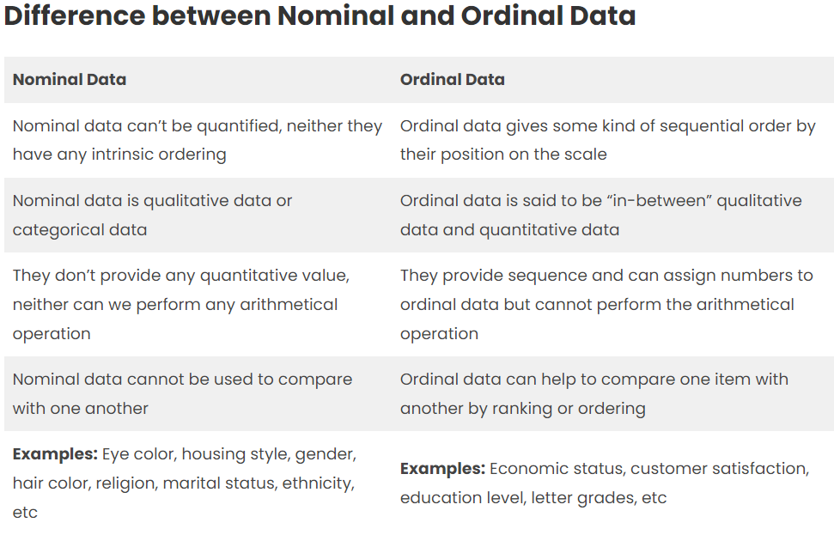

Slide 13
Discrete Data
The term discrete means distinct or separate. The discrete data contain the values that fall under integers or whole numbers. The total number of students in a class is an example of discrete data. These data can’t be broken into decimal or fraction values.
The discrete data are countable and have finite values; their subdivision is impossible. These data are represented mainly by a bar graph, number line, or frequency table.
Examples of Discrete Data :
Total number of students present in a class.
Cost of a cell phone.
Numbers of employees in a company.
The total number of players who participated in a competition.
Days in a week

Slide 14
Continuous Data
Continuous data are in the form of fractional numbers. It can be a person’s height, an object’s length, etc.
Continuous data represents information that can be divided into more minor levels. The continuous variable can take any value within a range.
Examples of Continuous Data :
Height of a person
Speed of a vehicle
“Time taken” to finish the work
Wi-Fi Frequency
Market share price

Slide 15
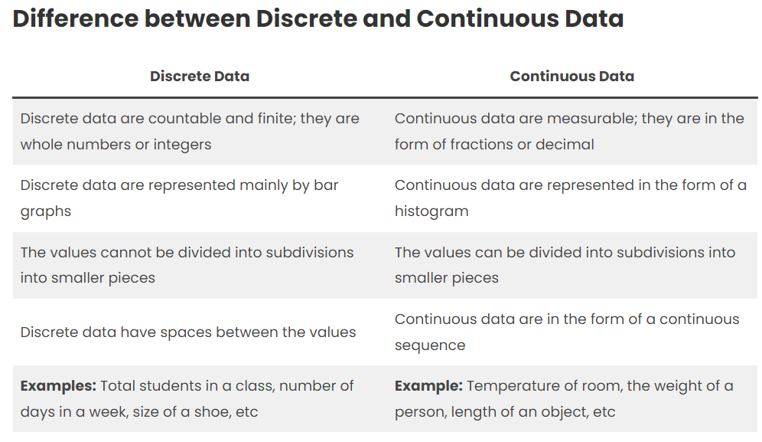

Slide 16
CATEGORICAL DATA

Slide 17
Identify individuals, variables and categorical variables
Biscuits are snacks liked by people of every age. The nutritional data of some famous Indian biscuits is as follows:
Biscuits | Type | Calories | Carbs
Krack Jack | Sweet and Salty | 16 | 2
Monaco | Salty | 15 | 1.8
Marie | Sweet | 25 | 6
Oreo | Sweet | 53 | 8
Nice | Sweet | 39 | 5

Slide 18
Identify individuals, variables and categorical variables
Q1. The individuals in this data set are:
Consumers
Biscuits (Ans)
Calories
Q2. The data set consists of:
3 variables, 1 of which is categorical (Ans)
Ans – Three variables (Type, Calories and Carbs) and (Type ) is a categorical variable
3 variables, 2 of which are categorical
2 variables, 1 of which is categorical

Slide 19
PICTOGRAPH

Slide 20
Pictograph
In Statistics, pictographs are charts used to represent data using icons and images relevant to the data.
All icons in the pictogram must be of the same size, but we can use the fraction of an icon to show the respective fraction of that amount. Let us understand the concept of pictographs using examples.

Slide 21
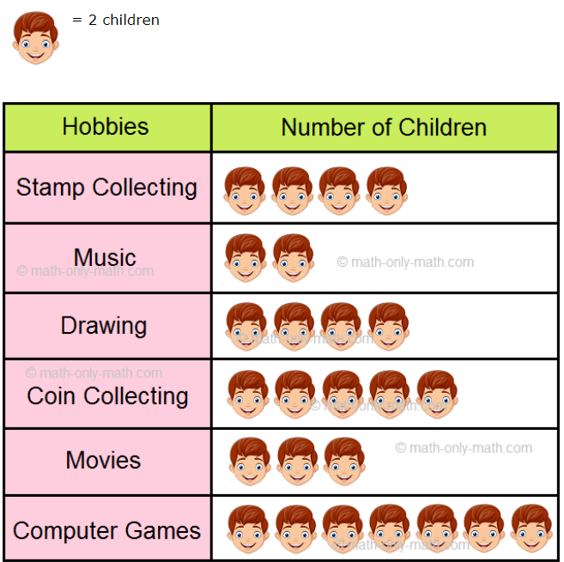
Pictograph
The number of children in a society with different hobbies is shown below.
Look at the pictograph and answer the questions.
Which is the most popular hobby?
Ans: Computer Games
Which is the least popular hobby?
Ans: Music
Which two hobbies are equally popular?
Ans: Stamp collecting and drawing
How many children are there in society?
Ans: 50 (one face = 2 Children)
How many hobbies do they have in all?
Ans: 6

Slide 22
BAR GRAPH

Slide 23
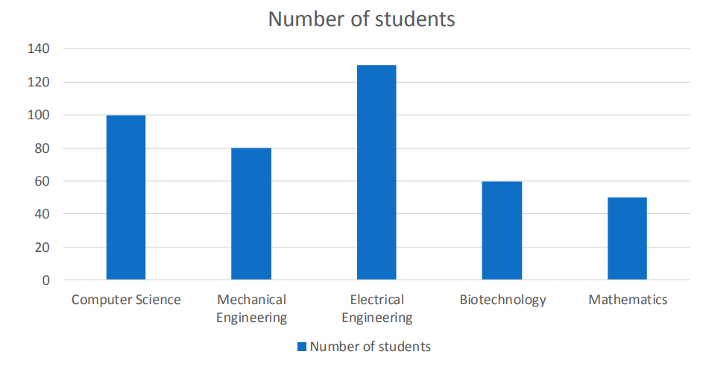
Bar Graph
A BAR graph is a graph made of bars whose heights represent the frequencies of respective categories is called a bar graph

Slide 24
Based on the data below, which country’s daily death count due to coronavirus has increased the most between 30th Mar’20 and 29th Jun’20? Ans: UK (Bar height is more for the UK compared to other counties 29th June 20)
Bar Graph

Slide 25
Example of a few Indian states having coronavirus cases Ans: Most of the coronavirus cases from Maharashtra and the least cases from Gujarat
Bar Graph

Slide 26
Reading bar chart along with the central tendency
Q1. What was the median percentage for the half-yearly exams?
Q2. What is the midrange percentage of the final exams?
Q3. What was the average student percentage for the half-yearly exams?
Q4. What is the range percentage of the final exams?

Slide 27
Reading bar chart along with the central tendency
Q1. What was the median percentage for the half-yearly exams?
Ans: Sort values in ascending order and select the middle value
Half-yearly Exam Marks – 90, 70, 80, 90
Sort the marks – 70, 80,90,90
Middle Value - 80 and 90
Median =(80+90) / 2 = 85
Q2. What is the midrange percentage of the final exams?
Ans: Range = Max value – Min Value
Marks in Final Exam =80,80,90,85
Min Value = 80 Max Value = 90 Range = 90-80 = 10
Mid Range = (Max + Min ) /2 = (90+80)/ 2 = 170/2 = 85

Slide 28
Reading bar chart along with the central tendency
Q3. What was the average student percentage for the half-yearly exams?
Ans: Average = (90+70+80+90)/ 4
=330/4 = 82.5
Q4. What is the range percentage of the final exams?
Ans: Range Percentage = (Max value – Min Value) percentage
Min Value = 80 Max Value = 90 Range = 90-80 = 10
Range Percentage = 10 %

Slide 29
PIE CHART

Slide 30
15 kids were asked about their favourite chocolate. 4 said ‘5 Star’, 6 said ‘Dairy Milk’, 3 said ‘Perk’ and 2 said ‘Kit-Kat’. Now let’s create a pie chart. Which are the most liked and the most disliked chocolates?
Ans: Most Liked = Dairy Milk Most disliked = Kit-Kat

Slide 31
TWO-WAY FREQUENCY TABLE AND VENN DIAGRAM

Slide 32
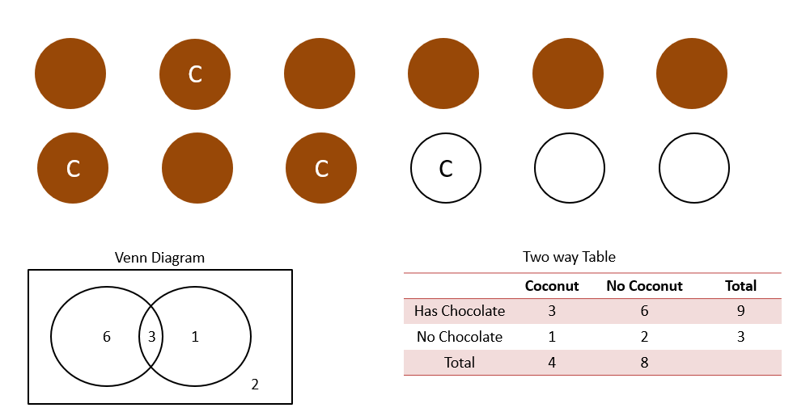
6 – Toffies with Chocolate no coconut 3- Toffies with Chocolate and Coconut
1- Toffies with coconut no Chocolate 2- Toffies without Chocolate or Coconut

Slide 33
MARGINAL AND CONDITIONAL DISTRIBUTION

Slide 34
Marginal Distribution
Marginal distribution is a frequency or relative frequency distribution of either the row or column variable. In a contingency table, a conditional distribution lists the relative frequency of each category of the response variable for a given value of the explanatory variable.
The distribution of each of these separate variables is called a marginal distribution. The marginal distributions in this table are shown in the table’s margins.

Slide 35
Marginal Distribution
For example, the following table shows the results of a survey that asked 100 people which subjects they like the most: mathematics, physics or chemistry.
For example, we would say that:
Mathematics: 34
Physics: 32
Chemistry: 34
Marginal distribution of sports in percentage terms:
Mathematics: 34 %
Physics: 32 %
Chemistry: 34 %
Marginal distribution of gender is:
Male: 48 %
Female: 52 %
 | Mathematics | Physics | Chemistry | Total
Male | 11 | 17 | 20 | 48
Female | 23 | 15 | 14 | 52
Total | 34 | 32 | 34 | 100

Slide 36
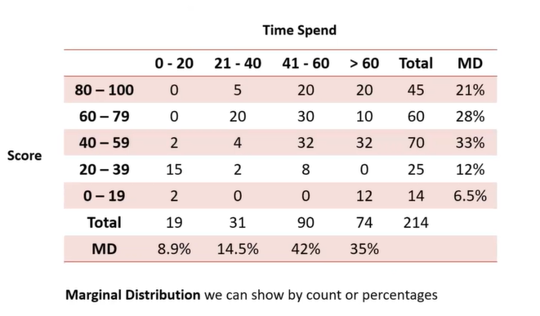
Marginal Distribution
Marginal Distribution can be shown by count or percentages
The following table shows the relation between score and minutes spend for studies

Slide 37
Conditional Distribution
A conditional distribution is a random variable’s probability distribution determined using conditional probability rules after observing the realization of another random variable.
For example, the following table shows the results of a survey that asked 100 people which sport they like the most: basketball, badminton, or football.
 | Badminton | Basketball | Football | Total
Male | 12 | 16 | 20 | 48
Female | 22 | 14 | 16 | 52
Total | 34 | 30 | 36 | 100

Slide 38
Conditional Distribution
 | Badminton | Basketball | Football | Total
Male | 12 | 16 | 20 | 48
Female | 22 | 14 | 16 | 52
Total | 34 | 30 | 36 | 100
The conditional distribution be calculated as:
Females who like Badminton: 22/52 = 0.423
Females who like Basketball: 14/52 = 0.269
Females who like Football: 16/52 = 0.307
The sum of the probabilities adds up to= 22/52 + 14/52 + 16/52 = 52/52 = 1
We can use conditional distributions to answer questions like
What are the chances that a person’s favourite sport is badminton if they are basketball?

Slide 39
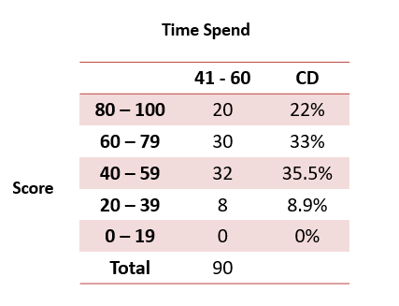
Conditional Distribution
Conditional Distribution is shown by percentages
Distribution of score given that students study between 41-60 minutes?

Slide 40
DISPLAYING QUANTITIVE DATA WITH GRAPHS

Slide 41
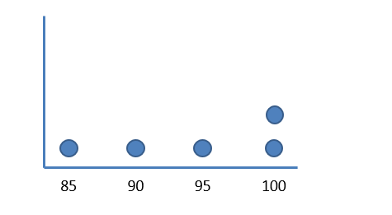
Name | Score
James | 90
John | 85
Andrew | 95
Sarah | 100
Cynthia | 100
Range: Max – Min
100 – 85 = 15
Below 100: 3
Most Frequent: 100

Slide 42
FREQUENCY TABLES AND DOT PLOTS

Slide 43
Age of students in class:
5, 7, 5, 9, 11, 12, 13, 9, 5, 10, 11, 13, 9, 10
Dot Plot
Frequency Table
Age | Frequency
5 | 3
6 | 0
7 | 1
8 | 0
9 | 3
10 | 2
11 | 2
12 | 1
13 | 2
5 6 7 8 9 10 11 12 13
Range: 13 – 5 = 8
How many are older than 9? Ans :7

Slide 44
HISTOGRAM

Slide 45
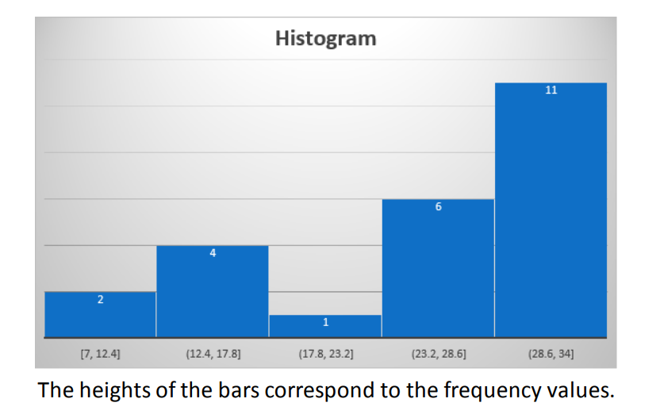
Histogram
Histogram is a graph consisting of bars of equal width drawn adjacent to each other. The horizontal scale represents classes of quantitative data values and the vertical scale represents frequencies.

Slide 46
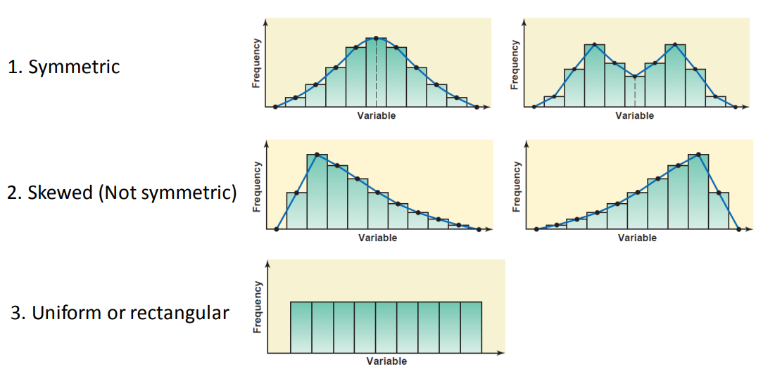
Histogram Shapes
Histogram is a graph consisting of bars of equal width drawn adjacent to each other. The horizontal scale represents classes of quantitative data values and the vertical scale represents frequencies.

Slide 47
Histogram
Age of students in class:
5, 7, 25, 19, 31, 42, 13, 9, 5, 10, 11, 13, 9, 10, 34, 45, 54, 55, 56, 43
Frequency Table
Histogram
Bins | Frequency
0-9 | 5
10-19 | 6
20-29 | 1
30-39 | 2
40-49 | 3
50-59 | 3
6
5
4
3
2
1
0-9 10-19 20-29 30-39 40-49 50-59

Slide 48
MEASURE OF CENTRAL TENDENCY

Slide 49
Measures Of Centre
A measure of Centre is a value at the Centre or middle of a data set.
• Mean
• Median
• Mode
• Mid-range

Slide 50
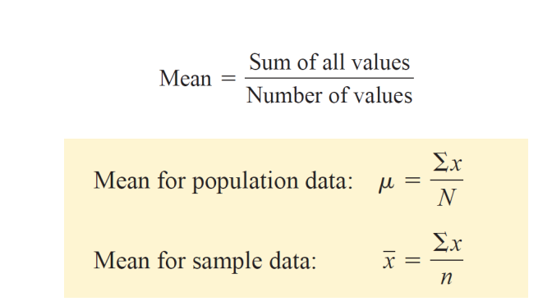
Mean
The Mean is obtained by dividing the sum of all values by the number of values in the data set
Where Σx is the sum of all values, N is the population size, n is the sample size, μ is the population mean, and x ̅is the sample mean

Slide 51
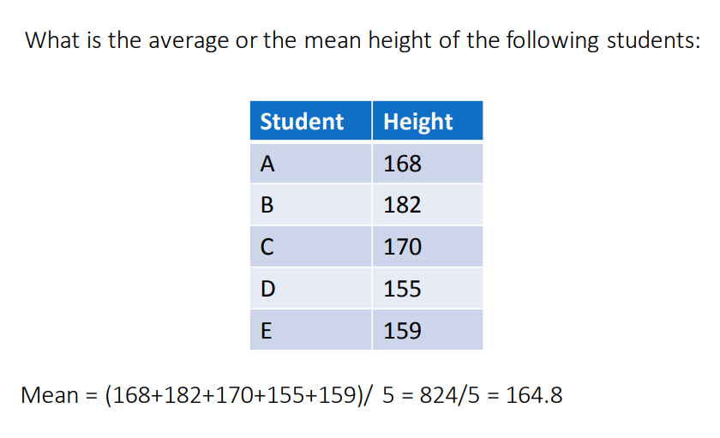
Mean

Slide 52
Median
The Median is the value of the middle term in a data set that has been ranked in increasing order.
Rank the data set in increasing order.
Find the middle term. The value of this term is the median.
Note that if the number of observations in a data set is odd, then the median is given by the value of the middle term in the ranked data.
However, if the number of observations is even, then the median is given by the average of the values of the two middle terms.

Slide 53
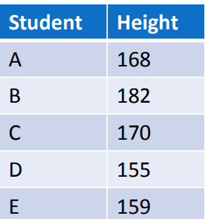
Median
The Median is the value of the middle term in a data set that has been ranked in increasing order
What is the median height of the following students:
Order in ascending order -> 155,159,168,179,182
Select the middle value -> 168

Slide 54
Mode
The Mode of a data set is the value that occurs with the greatest frequency.
When two data values occur with the same greatest frequency, each one is a mode and the data set is bimodal
When more than two data values occur with the same greatest frequency, each is a mode and the data set is said to be multimodal
When no data value is repeated, we say that there is no mode

Slide 55
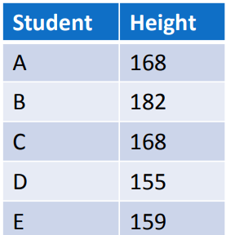
Mode
What is the Mode height of the following students:
168 appears two times while the rest of the values appear only once. Therefore, 168 is the Mode height

Slide 56
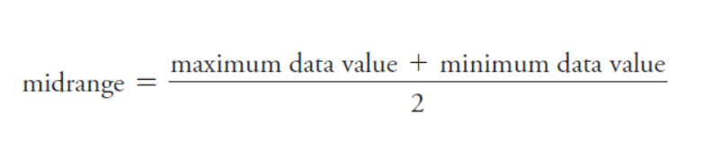
Midrange
The Midrange is the value midway between the maximum and minimum values in the original data set.

Slide 57
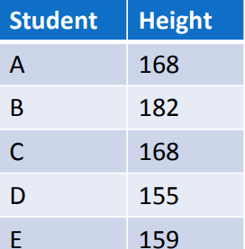
Midrange
The Midrange is the value midway between the maximum and minimum values in the original data set.
What is the Midrange of the following students:
Midrange = (155 + 182)/2 = 168.5

Slide 58
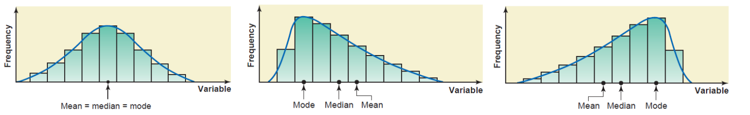
Comparison of Centres
For a symmetric distribution curve with one peak, the values of the mean, median, and mode are identical
For a distribution curve skewed to the right, the value of the mean is the largest, that of the mode is the smallest, and the value of the median lies between these two.
Mean is not always the best measure of central tendency because it is heavily influenced by outliers. The median is preferred over the mean for this reason
One advantage of the mode is that it can be calculated for both kinds of data—quantitative and qualitative— whereas the mean and median can be calculated for only quantitative data.

Slide 59
The measure of Central Tendency means Mean, Median and Mode
23, 30, 21, 32, 24, 22, 33, 21, 25, 32
Mean: 263/10 = 26.3
Median: To calculate median arrange in the sorted order
21 21 22 23 24 25 30 32 32 33
Since there is an even number of elements (10). The median is 24+25/2 = 24.5
Mode: In the above data 21 and 32 repeat two times. That means the mode is 21 and 32. This type of data is called bi-model data.

Slide 60
Example-1
James interviewed Juniors (15 students) and Seniors (11 students) at his university, asking them how many pieces of fruit they eat each day.
The results are shown next page
Which group has a high mean?
Ans: Juniors Mean = 6.93 Seniors Mean = 6.18.
Conclusion is mean of Juniors (6.93) is higher than the mean of seniors (6.18)
Is the mean a good measure for the centre of the distribution for seniors?
Ans: Seniors can go with mean, but juniors mean is not the right option due to outlier.
Can we use mean for the centre of the distribution for Juniors?
Ans: Due to the outlier mean is not the right option, better to go with the median in this case.

Slide 61
Example-1-Continue
Mean: 0+2+2+4+4+6+6+6+6+8+8+8+10+12+22
=104/15 = 6.93
Median = 6
Mode =6
Mean after excluding outlier 22= 82/14=5.85
Juniors
N= 15
0 2 4 6 8 10 12 14 16 18 20 22 24
Mean:0+2+4+6+6+6+6+8+8+10+12=68/11= 6.18
Median = 6
Mode=6
Seniors
N =11
0 2 4 6 8 10 12 14 16 18 20 22 24

Slide 62
Example-2
Atharv played 5 rounds of golf, and his lowest score was 80.
The scores of the first 4 rounds and the lowest round are shown in the following dot plot.
Ans: Score 80,85,90,92,95
Median =90 Mean= (80+85+90+92+95)/5 = 442/5= 88.4
Example continue in next page
80 85 90 95 100

Slide 63
Example-2- Continue…
It was found that Atharv broke some rules when he scored 80, so that score will be removed from the data set.
Median =90+92/2 =91
Mean =(85+90+92+95)/4 = 362/4 = 90.5
80 85 90 95 100
How will the removal of the lowest score affect the mean and the median?
Both the mean and the median will decrease, but the mean will decrease by more than the median.
Both the mean and the median will decrease, but the median will decrease by more than the mean.
Both the mean and the median will increase, but the mean will increase by more than the median.
Both the mean and the median will increase, but the median will increase by more than the mean.

Slide 64
Example-3
A group of 4 friends likes to bowl together, and each friend keeps track of his all-time highest score in a single game. Their high scores are all between 180 and 220, except for Atharv, whose highest score is 250.
Atharv then bowls a great game and has a new high score of 290.
How will increasing Atharv’s high score affect the mean and median?
Both the mean and median will increase
The median will increase, and the mean will stay the same
The mean will increase, and the median will stay the same
The mean will increase, and the median will decrease

Slide 65

Example-4
There are 11 salespeople. The median of sales is 6 and the Range is 4 (max value –min value)
At least one of the salesperson sold more than 10 cars.
True
False
Don’t know.
Ans: Assume there is one person who sold more than 10 cars. Then the number of cars sold by that person is at least 11.
Also mentioned Range is 4
Then Min value is 11-4 = 7
It also mentioned that the median is 6. If the median is 6 then the minimum value should be less than 6. But the minimum value 7. That means the statement
‘’At least one of the salesperson, sold more than 10 cars” is False

Slide 66
MEASURE OF SPREAD

Slide 67
Measure of Spread
Measures of spread (also called measures of dispersion) tell you something about how wide the set of data is. There are several basic measures of spread used in statistics.
The most common are:
The range (including the interquartile range)
The standard deviation
The variance
Quartiles

Slide 68
Interquartile Range (IQR)
The following data points represent the number of chocolates in each kid’s pocket.
4, 5, 11, 10, 7, 12, 6, 11, 13
Sort the data from least to greatest
Find the interquartile range (IQR) of the data set.
IQR = 75% percentile – 25 % Percentile
Sorted Data: 4, 5, 6, 7, 10, 11, 11, 12, 13
Median = 10 (50% Percentile)
25 % Percentile = 5.5
75% Percentile = 11.5
IQR = 11.5 – 5.5 = 6

Slide 69
Interquartile Range (IQR)
Find the interquartile range (IQR) of the data shown in the dot plot below:
Here the data is talking about Movies on each album in James’s collection
0 2 4 6 8 10 12 14 16 18 20 22 24
The Data is
4 6 6 6 8 8 10 12 14
Median = 6+8 = 14/2 = 7 (50% Percentile)
25 % Percentile = 6 75 % Percentile = 10
IQ R = 10-6 = 4

Slide 70
Sample 1
Sample 2
-10, 0, 10, 20, 30
8, 9, 10, 11, 12
Mean:-10+0+10+20+30= 50/5=10
Median: 10
Mode: NA
Range: Max – Min = 30- (-10) = 40
Variance: (sqr(-10-10(Mean))+ sqr(0-10)+ sqr(10-10)
sqr(20-10)+sqr(30-10))/5 (Number of Sample)
= 400+100+0+100+400/ 5 = 1000/ 5 = 200
Standard Deviation= SQRT (Variance) =
SQRT(200) = 14.14
Ie Sample 1 Data is More spread
Mean:-8+9+10+11+12 = 50/5=10
Median: 10
Mode: NA
Range: 12-8 = 4
Variance: sqr(8-10)+ sqr(9-10)+ sqr(10-10)+ sqr(11-10)+
sqr(12-10)/ 5 = (4+1+0+1+4 )/5 = 10/ 5 = 2
Standard Deviation: SQRT (2) = 1.41

Slide 71
Here is the data which consists of the employees with years of experience in data science,
find the mean and the variance
Data Set | Deviation From Mean Mean = 32/5 = 6.4 | SQR of Deviation
1 | -5.4 | 29.16
3 | -3.4 | 11.56
6 | -0.4 | 0.16
7 | 0.6 | 0.36
15 | 8.6 | 73.96
 | Sum | 115.2
 | Variance (Sum/N) | =(115.2/5) = 23.04
 | STD = SQRT (Variance) | 4.8
1
3
6
7
15

Slide 72
Here is the data which consists of the employees with the years of experience in data science,
find the standard deviation
Data Set | Deviation From Mean | SQR of Deviation
1 | -5.4 | 29.16
3 | -3.4 | 11.56
6 | -0.4 | 0.16
7 | 0.6 | 0.36
15 | 8.6 | 73.96
 | Sum | 115.2
 | Variance | 23.04
 | STD = SQRT (Variance) | 4.8
1
3
6
7
15

Slide 73
Which distribution has the highest standard deviation?
Ans : 2nd Data Set
Data Set |  |  |  |  |  |  |  |  |  |  | STD
4 | 4 | 6 | 6 | 6 | 8 | 8 | 10 | 12 | 14 |  | 3.155947
0 2 4 6 8 10 12 14 16 18 20 22 24
Data Set |  |  |  |  |  |  |  |  |  |  |  |  |  | STD
4 | 4 | 6 | 6 | 6 | 8 | 8 | 10 | 12 | 14 | 14 | 18 | 20 |  | 5.023024
0 2 4 6 8 10 12 14 16 18 20 22 24

Slide 74
Mean and Standard Deviation vs. Median and Interquartile range (IQR)
Due to outliers, there is a high value for mean and standard deviation. When ever there is an outlier we prefer to use the median or interquartile range as the measure if central tendency.
35, 50, 50, 50, 56, 60, 60, 75, 260
Mean: 696/ 9 = 77.3
Standard Deviation: 65.37
Median: 56 (Middle Value )
Interquartile Range:
Q1 = 50 Q3 = 60+75 / 2 = 67.5
Q3- Q1 = 67.5 – 50 = 17.5
0 2 35 50 56 60 75 260

Slide 75
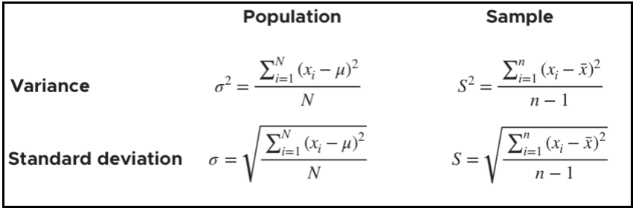
In statistics, Bessel's correction is the use of n − 1 instead of n in the formula for the sample variance and sample standard deviation, where n is the number of observations in a sample. This method corrects the bias in the estimation of the population variance.

Slide 76
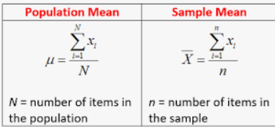
Population (Parameter) Sample (Statistic)
Mean:
Variance:
Population
Sample
N = 14
n = 3

Slide 77
Box Plot
Q1 – 1.5IQR
23 – 1.5*3 = 18.5
Q1 – 1.5IQR
Quartile 1
Age
4
23
24
24
26
26
60
Inter Quartile Range
IQR Q3 – Q1
Q3 – Q1
26 – 23 = 3
Quartile 2 or Median
Quartile 3
Q3 + 1.5IQR
Q3 + 1.5IQR
26 + 1.5*3 = 30.5

Slide 78
Find the range and the mid-range of the following set of numbers:
66, 83, 74, 88, 95, 78, 66, 84, 81
Sorted Data
66, 66, 74, 78, 81, 83, 84, 88, 95
Range = Max – Min = 95-66 = 29
Mid Range = (Max + Min)/2 =(95+66)/2 = 161/2 = 80.5

Slide 79
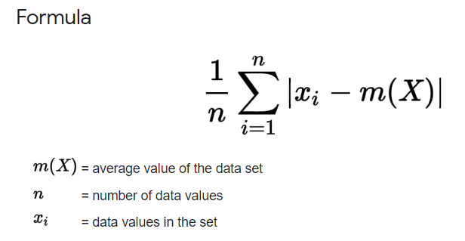
Mean Absolute Deviation (MAD)
2, 2, 4, 4
1, 1, 6, 4
Mean: 1+1+6+4= 12/4 = 3
MAD = (abs (1-3)+ abs (1-3)+ abs (6-3)+ abs (4-3))/4 = (2+ 2+ 3+1) /4 = 8/4 = 2
Mean: 2+2+4+4= 12/4 = 3
MAD = (abs (2-3)+ abs (2-3)+ abs (4-3)+ abs (4-3))/4
= 1+1+1+1= 4/4 = 1

Slide 80
Calculate Mean Absolute Deviation (MAD)
6
Data Set: 1 4 5 6
Mean = (1+4+5+6) / 4 = 16/ 4 =4
Median = (4+5) / 2 = 9/2 = 4.5
Variance = (sqr (1-4) + sqr (4-4) + sqr (5-4) + sqr (6-4) )/ 4
= (9+0+1+4) / 4 = 14/4 = 3.5
STD = SQRT (Variance) = SQRT (3.5) = 1.87
Range = Max – Min = 6-1 = 5
Mid Range = (Max+Min ) / 2 = (6+1)/ 2 = 7/2 = 3.5
MAD = (abs (1-4(Mean) + abs (4-4)+ abs (5-4) +abs (6-4)) /4 (N)
=(3+0+1+2)/4 = 6/4 = 1.5
5
4
1

